Slide 1
Philosophy and Theory of History
ইতিহাসের দর্শন এবং তত্ত্ব
CC-XII, Unit III

Slide 2
What is History? ইতিহাস কি?

Slide 3
Continued

Slide 4
Continued

Slide 5
Continued

Slide 6
Continued

Slide 7
So, we ask again: what is history?
The word history comes ultimately from Ancient Greek historía, meaning “inquiry,” “knowledge from inquiry,” or “judge.”
Therefore, broadly, it can be defined as the study of the past
When we say that it means study of imprints of past and the study of the past inquiries
So, we do not just inquire about the past through imprints left by it but about the past studies into the imprints, as well

Slide 8
Study of History?
So, what is this study of past inquiries?
Does it mean we study the sources of history, as they are known?
NO
It means we study along with sources the past inquiries by historians or chroniclers into the imprints of the past.

Slide 9
উপাদানের ধরন।
Types of sources
Sources/উপাদান
written/লিখিত
archaeological/ প্রত্নতাত্ত্বিক
oral/ মৌখিক

Slide 10
Are Sources Facts of History?
ঐতিহাসিক উপাদানগুলি কি ইতিহাসের তথ্য?
Time past
Imprints
Sources
Historian
Reconstructs
Facts/
History

Slide 11
Are they???
No, sources are not facts of history, they are turned into facts in the head of the assessor, or who we refer to as the historian.
উপাদান ইতিহাসের তথ্য নয়। উপাদানকে তথ্যে পরিণত করেন ঐতিহাসিক তার বিশ্লেষণে

Slide 12
তাহলে তথ্য কি?
So, what are historical facts?
Anything that is sifted through by the historian in the act of reconstructing a time in sources and are put together for the sake of reconstruction can be defined as Facts. But, sources that are deemed FACTS attain the status in the endeavor of the Historian

Slide 13
What is it then?
History
ইতিহাস
Proper History
সঠিক ইতিহাস
Metanarrative
মেটান্যারেটিভ

Slide 14
What is Proper History?
Proper history pursues the modest aim of identifying the plan or the goal of the historical process as a whole and eschews the impulse of solving the riddle of history
Seeks to explain what happened in the past by providing a precise and accurate reconstruction of the events reported in the documents
All impulses of interpreting the data is suppressed or else it astutely mentions where facts are presented, as it is, and where it is interpreted
So, here it is explained, and not interpreted, and a clear distinction is marked between the two.

Slide 15
Metanarrative
Explanative and interpretative aspects of the narrative run together
So deeply entwined are they that the distinction between the two disappear
It is often referred to as speculative history as well

Slide 16
Elton Vs. Carr
Geoffrey Elton, The Practice of History (1967) Empiricist/Objectivist
E. H. Carr, What is History? (1961) Subjectivist
This spat between Elton and Carr on the status of historical knowledge is by common consent the defining debate about how the study of the past should be approached.

Slide 17
Geoffrey Elton
According to Elton, the successful resolution of all historical problems depends upon the appropriate use of evidence. To this end three main stages of reading evidence are required: a review of the available evidence (what sources exist?), the informed criticism of that evidence (what exactly does it testify to?), and from that evidence the framing of answers (what actually happened in the past?). Historical research must therefore ‘arise from the evidence not from the mind of the enquirer’, thereby avoiding the ‘preconceived notions’ of the historian. By following these guidelines, the historian ‘well trained in the principles of scholarship’ can reveal the truth, or ‘as near to the truth of the past as he has any hope of getting’
The historian must act only as a conduit through which the experiences of the past travel while a relationship with the dead provides the thrill and the challenge of history.

Slide 18
E. H. Carr
For Carr, history is subjective because historians are recognised as part of the process of doing history, unable to separate prejudices and presuppositions from conclusions drawn solely from evidence. It is this factor above all others that has secured Carrs’ reputation as a radical in his approach to history

Slide 19
A quick discussion of the point
To illustrate these points developed from the opening section, we want to use the extract about the Indian Mutiny from Percival Spear’s 1990 book A History of India.

Slide 20
Continued
So, if we were researching the cause and effects of the Mutiny of 1857 from which we began this section, and particularly its effect on British colonial authority, we may note the following evidential facts:
1 The Indian Mutiny ended in the summer of 1858.
2 Most of the rebel leaders were killed, executed or disappeared.
3 Clamour for vengeance against the Indians was tempered by the Viceroy Lord Canning and the Governor of the Punjab, Sir John Lawrence.
4 Delhi lost its independence and was incorporated within the Punjab.

Slide 21
Continued
5 The East India Company lost its colonial authority, the Indian army was reorganised and Indians began to be incorporated into the apparatus of government.
6 Queen Victoria issued a proclamation in November 1858 which outlined new policies toward India.
In order to save time, these ‘facts’ are listed in a rough chronological order. They are all evidential facts which cannot seriously be disputed, at least not without some difficulty. But in themselves - even when arranged in the order that they happened - they say nothing about the nature, causes or effects of the Indian Mutiny.

Slide 22
Continued
Let us, however, look in a little more detail at what is going on in the passage.
A number of important points follow from this:
1 The story is put together by linking the various chronological elements in causal relationships. The Indian Mutiny resulted in the death or disappearance of many of the rebel leaders. In the immediate aftermath there were demands for vengeance but these were silenced by the British authorities.
2 The story thus unfolds as a secondary elaboration of a narrative of British colonial authority in India.

Slide 23
Continued
But although the Mutiny was a tragedy, in the longer term it promoted progressive forces of cooperation and hope which once again led to a happy and benign colonial relationship. Just consider how the language in the passage reinforces this narrative. India was ‘inert’ and ‘lacerated’; the ‘wisdom’ of Canning, the ‘strength’ of Lawrence muting the cries for vengeance; ‘good came out of the evil of the mutiny’.
This narrative is part of a larger narrative that Spear inhabits. Here colonial rule is exercised by the British as progressive and benign and operates for the benefit of both colonisers and colonised.

Slide 24
Continued
The story, however, is only one of many that can be constructed using this chronicle. Another, from the perspective of an Indian rebel could certainly be imagined or even retrieved from exactly the same evidence but is not given a voice by Spear. As an alternative history, then, we could interpret the evidence as follows:

Slide 25
Continued
After years of suppression large sections of the Indian population decided to take matters in their own hands and drive the British out of India.
The revolt was nearly successful, but because of the military superiority of the British and their access to technology such as the telegraph, the nationalist struggle was defeated.
The British press cried out for vengeance against those who had been responsible for the atrocities. Many of the rebels were executed,
The British government now recognised that their rule could no longer be based on military power alone, and therefore decided to take due account of India’s religion and customs in order not to cause offence, and assimilate influential sections into the British ruling elite as a means of diverting them from future nationalist struggle.

Slide 26
Continued
What this example illustrates is that seemingly objective accounts based on hard factual evidence are deeply riven by ideological influences, such as the historian’s feelings about the nature of British rule in India. Here there is a critical difference between historical and evidential truth. There are certain truths in history - interpretations which cannot easily be refuted - although, as Carr argued, through a dialogue between theory and evidence we can only approach historical truth but never truly arrive there.

Slide 27
Role of Interpretation ?
ব্যাখ্যার ভূমিকা কি?
Theorists of historiography generally agree that all historical narratives contain an irreducible and inexpungable element of interpretation
The historian has to interpret his materials in order to construct the moving pattern of images in which the form of the historical process is to be mirrored
On the one hand, there are always more facts in the record than the historian can possibly include in the narrative so the historian must "interpret" the data by excluding certain facts from the account as irrelevant to his/her narrative purpose.
On the other hand, in his efforts to reconstruct "what happened" in any given period of history, the historian inevitably must include in his narrative an account of some event or complex of events for which the facts that would permit a plausible explanation of its occurrence are lacking.
A historical narrative is thus necessarily a mixture of adequately and inadequately explained events, a congeries of established and inferred facts

Slide 28
Is interpretation inevitable?
During the nineteenth century, four major theorists of historiography- Hegel, Droysen, Nietzsche, and Croce- rejected the myth of objectivity.
Hegel identified 4 types of interpretation within the class of what he identified as Reflective Historiography: Universal, Pragmatic, Critical and Conceptual
Droysen: Causal, Conditional, Psychological and Ethical
Nietzsche: Monumental, Antiquarian, Critical and “Superhistorical Approach”
Croce: Positivist, idealist, Romantic and Critical

Slide 29
Why at all interpret?
For Droysen, interpretation was necessary simply because the historical record was incomplete. Sometiemes even if we are able to say what happened based on the facts we are unable to say why it happened. That is where comes in interpretation.
According to Nietzsche the value of history lay “in inventing ingenious variations on a probably commonplace theme, in raising the popular melody to a universal symbol and showing that the world of depth and showing what a world of depth, power, and beauty exists in it.”
Hegel and Croce sought to ground the historian’s insights into reality in the poetic intuition of the particular.

Slide 30
How does a historian interpret?
Levi Strauss in his book The Savage Mind opined that all historical narrative consist of a fraudulent outline. Such accounts are inevitably interpretive.
Any historical event, be it revolution or war, can be resolved into a multitude of psychic moment where- some sort of unconscious development that resolves themselves into cerebral, or hormonal or nervous phenomena which themselves have reference to the physical and chemical order.
Hence he concludes historical facts are not given to the historians but are constructed by the historian by abstraction as though under the threat of an infinite regress.

Slide 31
How does it work
History is never simply history, it is history-for that is history written in the interest of some infra-scientific aim or vision.
Northrop Frye though aggreging to the constructive nature of history warns a historians that he/she must interpret inductively by introducing different patterns that he/she believes to have seen in the facts, and must never interpret deductively.
R. G. Collingwood suggested a two fold interpretive strategy: critical and constructive. Constructive imagination can applied in this case and certain facts can be rejected based on the theoretical framework of the time, that is the time of the historian.

Slide 32
How does it become a part of history?
Interpretation thus enters history in 3 ways:
Aesthetically (in the choice of narrative strategy)
Epistemologically (in the choice of the explanatory paradigm)
Ethically (in the choice of strategy by which the ideological implications of a given representation can be drawn or the comprehension of the current social problems)

Slide 33
What is Philosophy of History?
Philosophy of history, the study either of the historical process and its development or of the methods used by historians to understand their material.

Slide 34
Types of Interpretation
The notion of philosophical reflection upon history and its nature is consequently open to more than one interpretation,
On the one hand, they have distinguished philosophy of history in the traditional or classical sense; this is conceived to be a first- order enquiry, its subject matter being the historical process as a whole and its aim being, broadly speaking, one of providing an overall elucidation or explanation of the course and direction taken by that process.
On the other hand, they have distinguished philosophy of history considered as a second-order enquiry. Here attention is focused not upon the actual sequence of events themselves but, instead, upon the procedures and categories used by practicing historians in approaching and comprehending their material.

Slide 35
Classification/ শ্রেণিবিন্যাস
Interpretation
বিশ্লেষণ
Speculative
সংশয়বাদী
Critical
সমালোচনামূলক

Slide 36
Categories: western history writing
Graeco Roman Tradition
Medieval Church tradition
Early Renaissance tradition
Enlightenment Progressive tradition
Romanticism, Historicism and Nationalism
Positivism
Marxist
Annales
Neo Marxist
Post Modernist
Post Structuralist

Slide 37
Interpretation: Indian historiography
Imperialist
Nationalist
Marxist
Cambridge
Subaltern
Post colonial
Post Modernist

Slide 38
Hypothesis
A tentative explanation for an observation, phenomenon, or scientific problem that can be tested by further investigation.
The hypotheses in historical research are useful in explaining events, conditions or phenomena of the period in question.
Hypotheses are particularly necessary in studies where cause and effect relationship are to be discovered.
They are perhaps, less crucial in studies in which the task is one of determining the status of given phenomenon although even in such studies the investigator is likely to need some tentative hypothesis to guide him to the areas worth exploring.

Slide 39
What is hypothesis?
First of all, we need a historical hypothesis when our evidence is limited. That is to say, we infer from evidence and argumentation in order to establish a likely explanation for something that is open to question or interpretation.
Second, according to most historians, a good hypothesis should give us the simplest explanation with the most explanatory power. A historical hypothesis should not create more problems than it solves.

Slide 40
Types of Hypothesis
Simple Hypothesis
Complex Hypothesis
Empirical Hypothesis
Null Hypothesis (Denoted by "HO")
Alternative Hypothesis (Denoted by "H1")
Logical Hypothesis
Statistical Hypothesis

Slide 41
Simple hypothesis
A simple hypothesis is a prediction of the relationship between two variables: the independent variable and the dependent variable.

Slide 42
Complex hypothesis
A complex hypothesis examines the relationship between two or more independent variables and two or more dependent variables.

Slide 43
Null hypothesis
A null hypothesis (H0) exists when a researcher believes there is no relationship between the two variables, or there is a lack of information to state a scientific hypothesis. This is something to attempt to disprove or discredit.

Slide 44
Alternative Hypothesis
In an attempt to disprove a null hypothesis, researchers will seek to discover an alternative hypothesis.

Slide 45
Logical hypothesis
A logical hypothesis is a proposed explanation possessing limited evidence. Generally, you want to turn a logical hypothesis into an empirical hypothesis, putting your theories or postulations to the test.

Slide 46
Empirical Hypothesis
An empirical hypothesis, or working hypothesis, comes to life when a theory is being put to the test, using observation and experiment. It's no longer just an idea or notion. It's actually going through some trial and error, and perhaps changing around those independent variables.

Slide 47
Statistical Hypothesis
A statistical hypothesis is an examination of a portion of a population.

Slide 48
Argumentation
Historical arguments, academic arguments based on scholarship, have different goals and use different strategies than polemic/advocacy arguments.
Central to the difference between academic arguments and polemic arguments is the audience.
In academic arguments, the audience is composed of other experts, scholars who are often at least as knowledgeable about the field as the writer is.
Even when a historian locates a primary document in some attic or archive that no one has every come across, part of writing about that document is to explain how it changes the way the discipline, composed of other experts, thinks about an event.

Slide 49
Internal structure of arguments
Typically an argument has an internal structure, comprising the following
a set of assumptions or premises
a method of reasoning or deduction and
a conclusion or point.

Slide 50
Historical argumentation as interpretive argumentation
Interpretive argumentation is a dialogical process in which participants explore and/or resolve interpretations often of a text of any medium containing significant ambiguityin meaning.
Interpretive argumentation is pertinent to the humanities, hermeneutics, literary theory, linguistics, semantics, pragmatics, semiotics, analytic philosophy and aesthetics. Topics in conceptual interpretation include aesthetic, judicial, logical and religious interpretation. Topics in scientific interpretation include scientific modeling.

Slide 51
Problematique
Problematique is A research question is 'a question that a research project sets out to answer.
Choosing a research question is an essential element of both quantitative and qualitative research. Investigation will require data collection and analysis, and the methodology for this will vary widely.
Good research questions seek to improve knowledge on an important topic, and are usually narrow and specific.

Slide 52
Continued
"Problematique" is a term that functions analogously to the research problem or question used typically when addressing global systemic problems.
The term achieved prominence in 1970 when Hasan Özbekhan, Erich Jantsch and Alexander Christakis conceptualized the original prospectus of the Club of Rome titled "The Predicament of Mankind".
In this prospectus the authors designated 49 Continuous Critical Problems facing humankind, saying "We find it virtually impossible to view them as problems that exist in isolation – or as problems capable of being solved in their own terms... It is this generalized meta system of problems, which we call the 'problematique' that inheres in our situation."

Slide 53
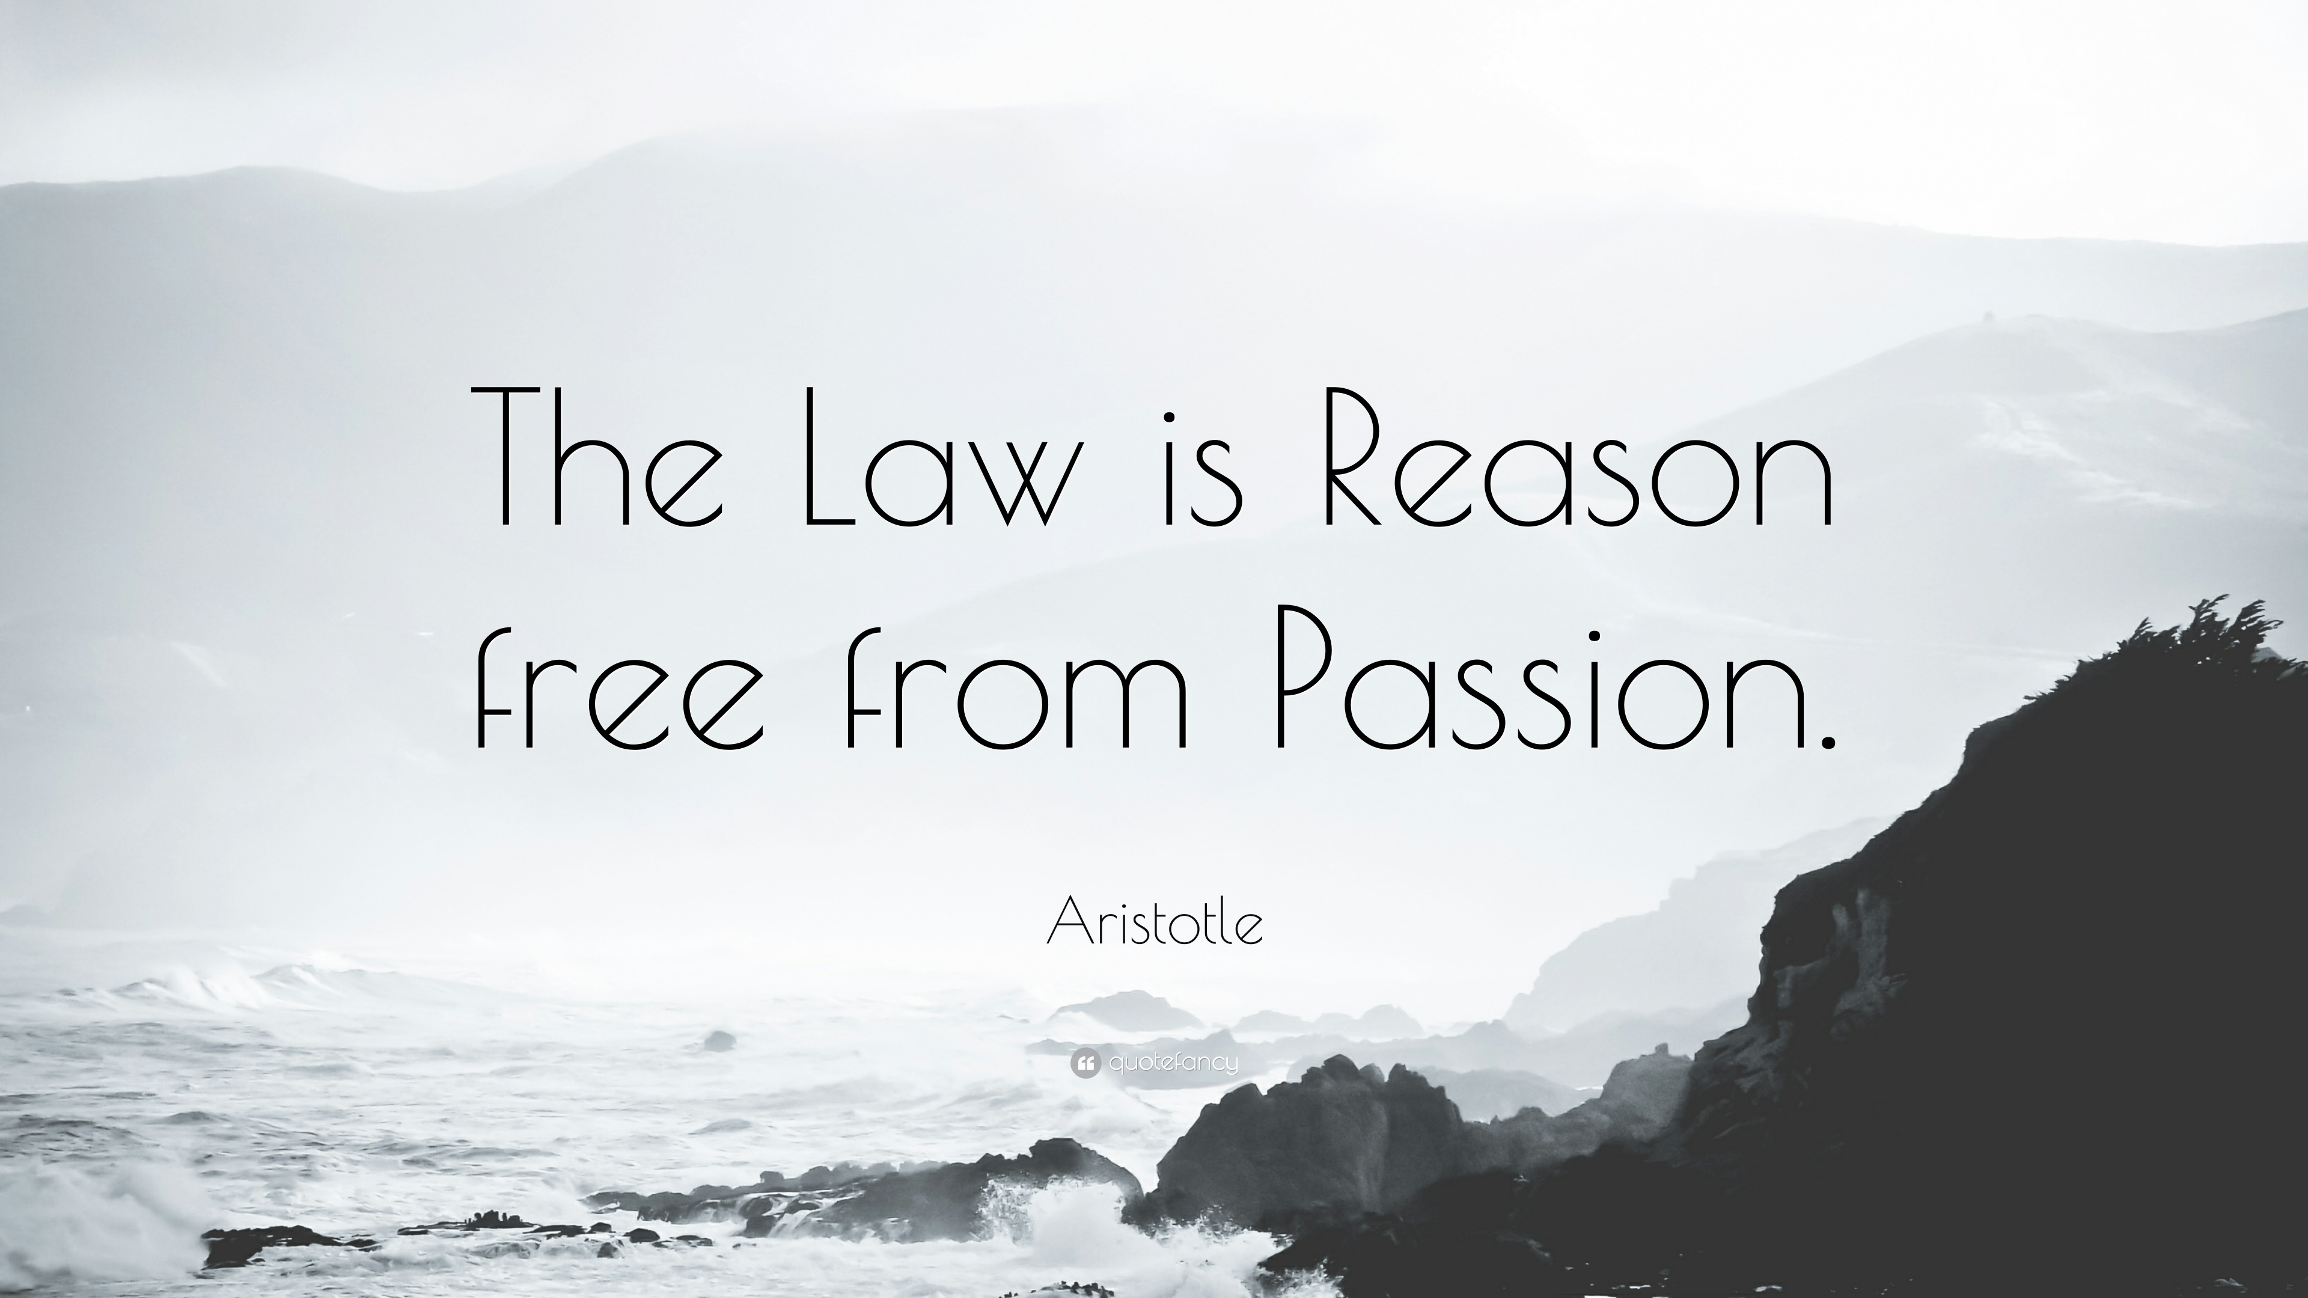

Slide 54
Subjectivity
Historical subjectivity begins with the individual scholar’s perception of her connection to, and distance from, the past, and it is sustained through the historian’s decision to make that perception integral to her scholarship.
subjectivity is not the opposite of objectivity
In other words, historical subjectivity is an expression of an individual’s historical consciousness. And historical consciousness would not exist without some individual’s desire to understand what that connected separation entails.

Slide 55
Continued
As we shall see, expressions of historical subjectivity congregate around scholarship on the war. From within this concert of reading and writing to and from “subject positions” (which, after all, begin and end up embodied), we can begin to explore the ways in which “the personal,” self-reflexivity, and/or the first-person voice appear in contemporary historical narrative as “historical sub- jectivity.”

Slide 56
Objectivity
By objectivity, we mean dispassionate, disinterested and scientific treatment of all events which would be depicted by a historian as if he was a judge pronouncing his verdict in the most impartial way without any fear or favour.
Historical knowledge is not purely intuitive because it is derived from a critical examination of source material and is checked by further reference to the source. Historical objectivity is closely related to value-judgment.
Objectivity requires the historian and his/her analysis of events and personalities to be value free. It must be as Ranke and Elton proclaimed free of all prejudices.

Slide 57
Continued
It is because this historian cannot back up the statements he makes with scientific proof that many people feel that historical knowledge is subjective rather than objective. The very subject matter of history being reflective thought such subjectivity become inevitable.
Voltaire pointed out that history is a pack of tricks we play upon the dead. An element of subjectivity enters at every step in the process of investigation; the present can and does influence our knowledge of the past.
Every historian has his own likes, tastes, aptitude and preferences. He may choose either political or social or economic or military or constitutional or art-history and because he or she is specially inclined towards that particular subject, he or she is likely to be affected by it. Froude’s history gives us an impression of the course of events that is entirely different. Karl Marx would pick only the class struggle, Hegel would concentrate on human spirit. Acton on freedom.

Slide 58
Can there be objective history?
Historical objectivity is not attainable because of three factors such as- the nature of historical events, the selection of historical events and the personality of the author, his motives intentions and temperament.
Historian works under certain limitations. All the facts or events are not well preserved or stored for him. The source material or evidence that might have contained facts might have been destroyed, or those who recorded the events might not have observed very well or even if they observed, they might have, deliberately omitted to record them.
The historian himself be a victim of ideological considerations, political thoughts and commitment, group prejudice, national feelings, patriotic zeal and partisan attitude. When Barani or Abul Fazl wrote their “Tarikh-i-Ferozshahi” and “Akbarnama” respectively, they were not free from their political considerations or loyalty to their master.

Slide 59
Continued
The historical material of medieval Empire contains lot of distorted material. Religious superiority, racial prejudice, group affiliations, national pride, party inclination and connection, social inhibition, linguistic inclinations have influenced the historical writings.
The racial complexion also mars the objectivity of the history such as English vs. Indian historians. The exponents of the philosophy of history have generally followed such a selective approach as to establish that history has worked along a set pattern.
Certain other factors too might stand in the way of objectivity such as political pressure, party loyalties, religious fanaticism etc.

Slide 60
Historical Narrative
Narrative history is the practice of writing history in a story-based form.
It tends to entail history-writing based on reconstructing series of short-term events, and since the influential work of Leopold von Ranke on professionalising history-writing in the nineteenth century has been associated with empiricism.
The term narrative history thus overlaps with the term histoire événementielle ('event-history') coined by Fernand Braudel in the early twentieth century, as he promoted forms of history-writing analysing much longer-term trends (what he called the longue durée)

Slide 61
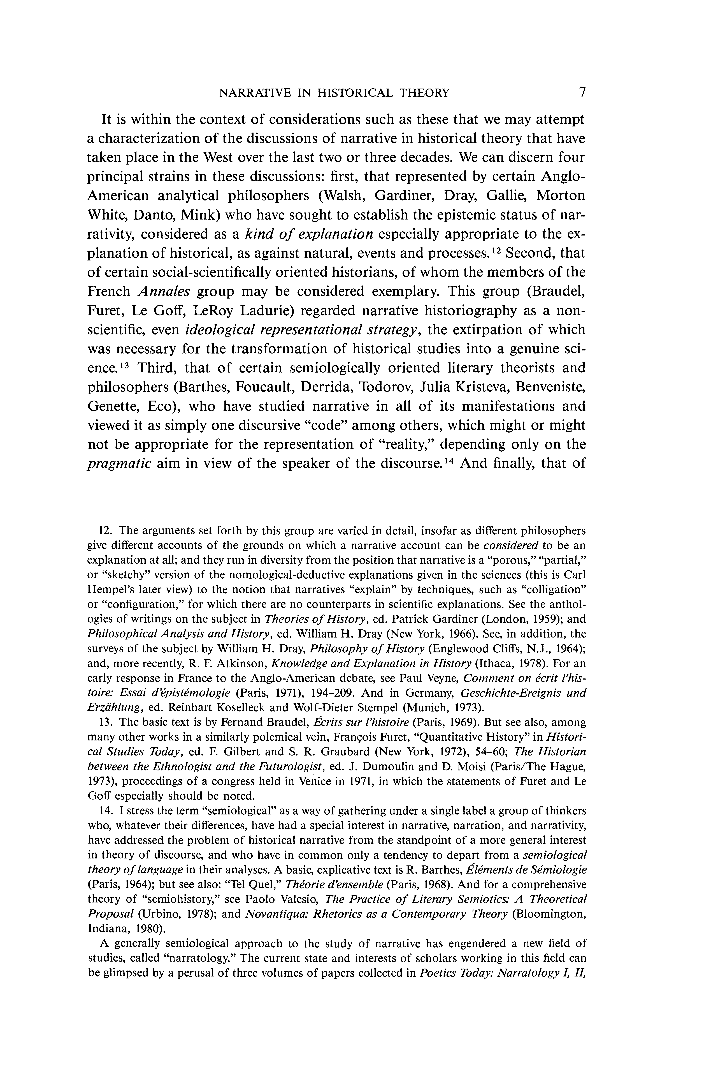

Slide 62
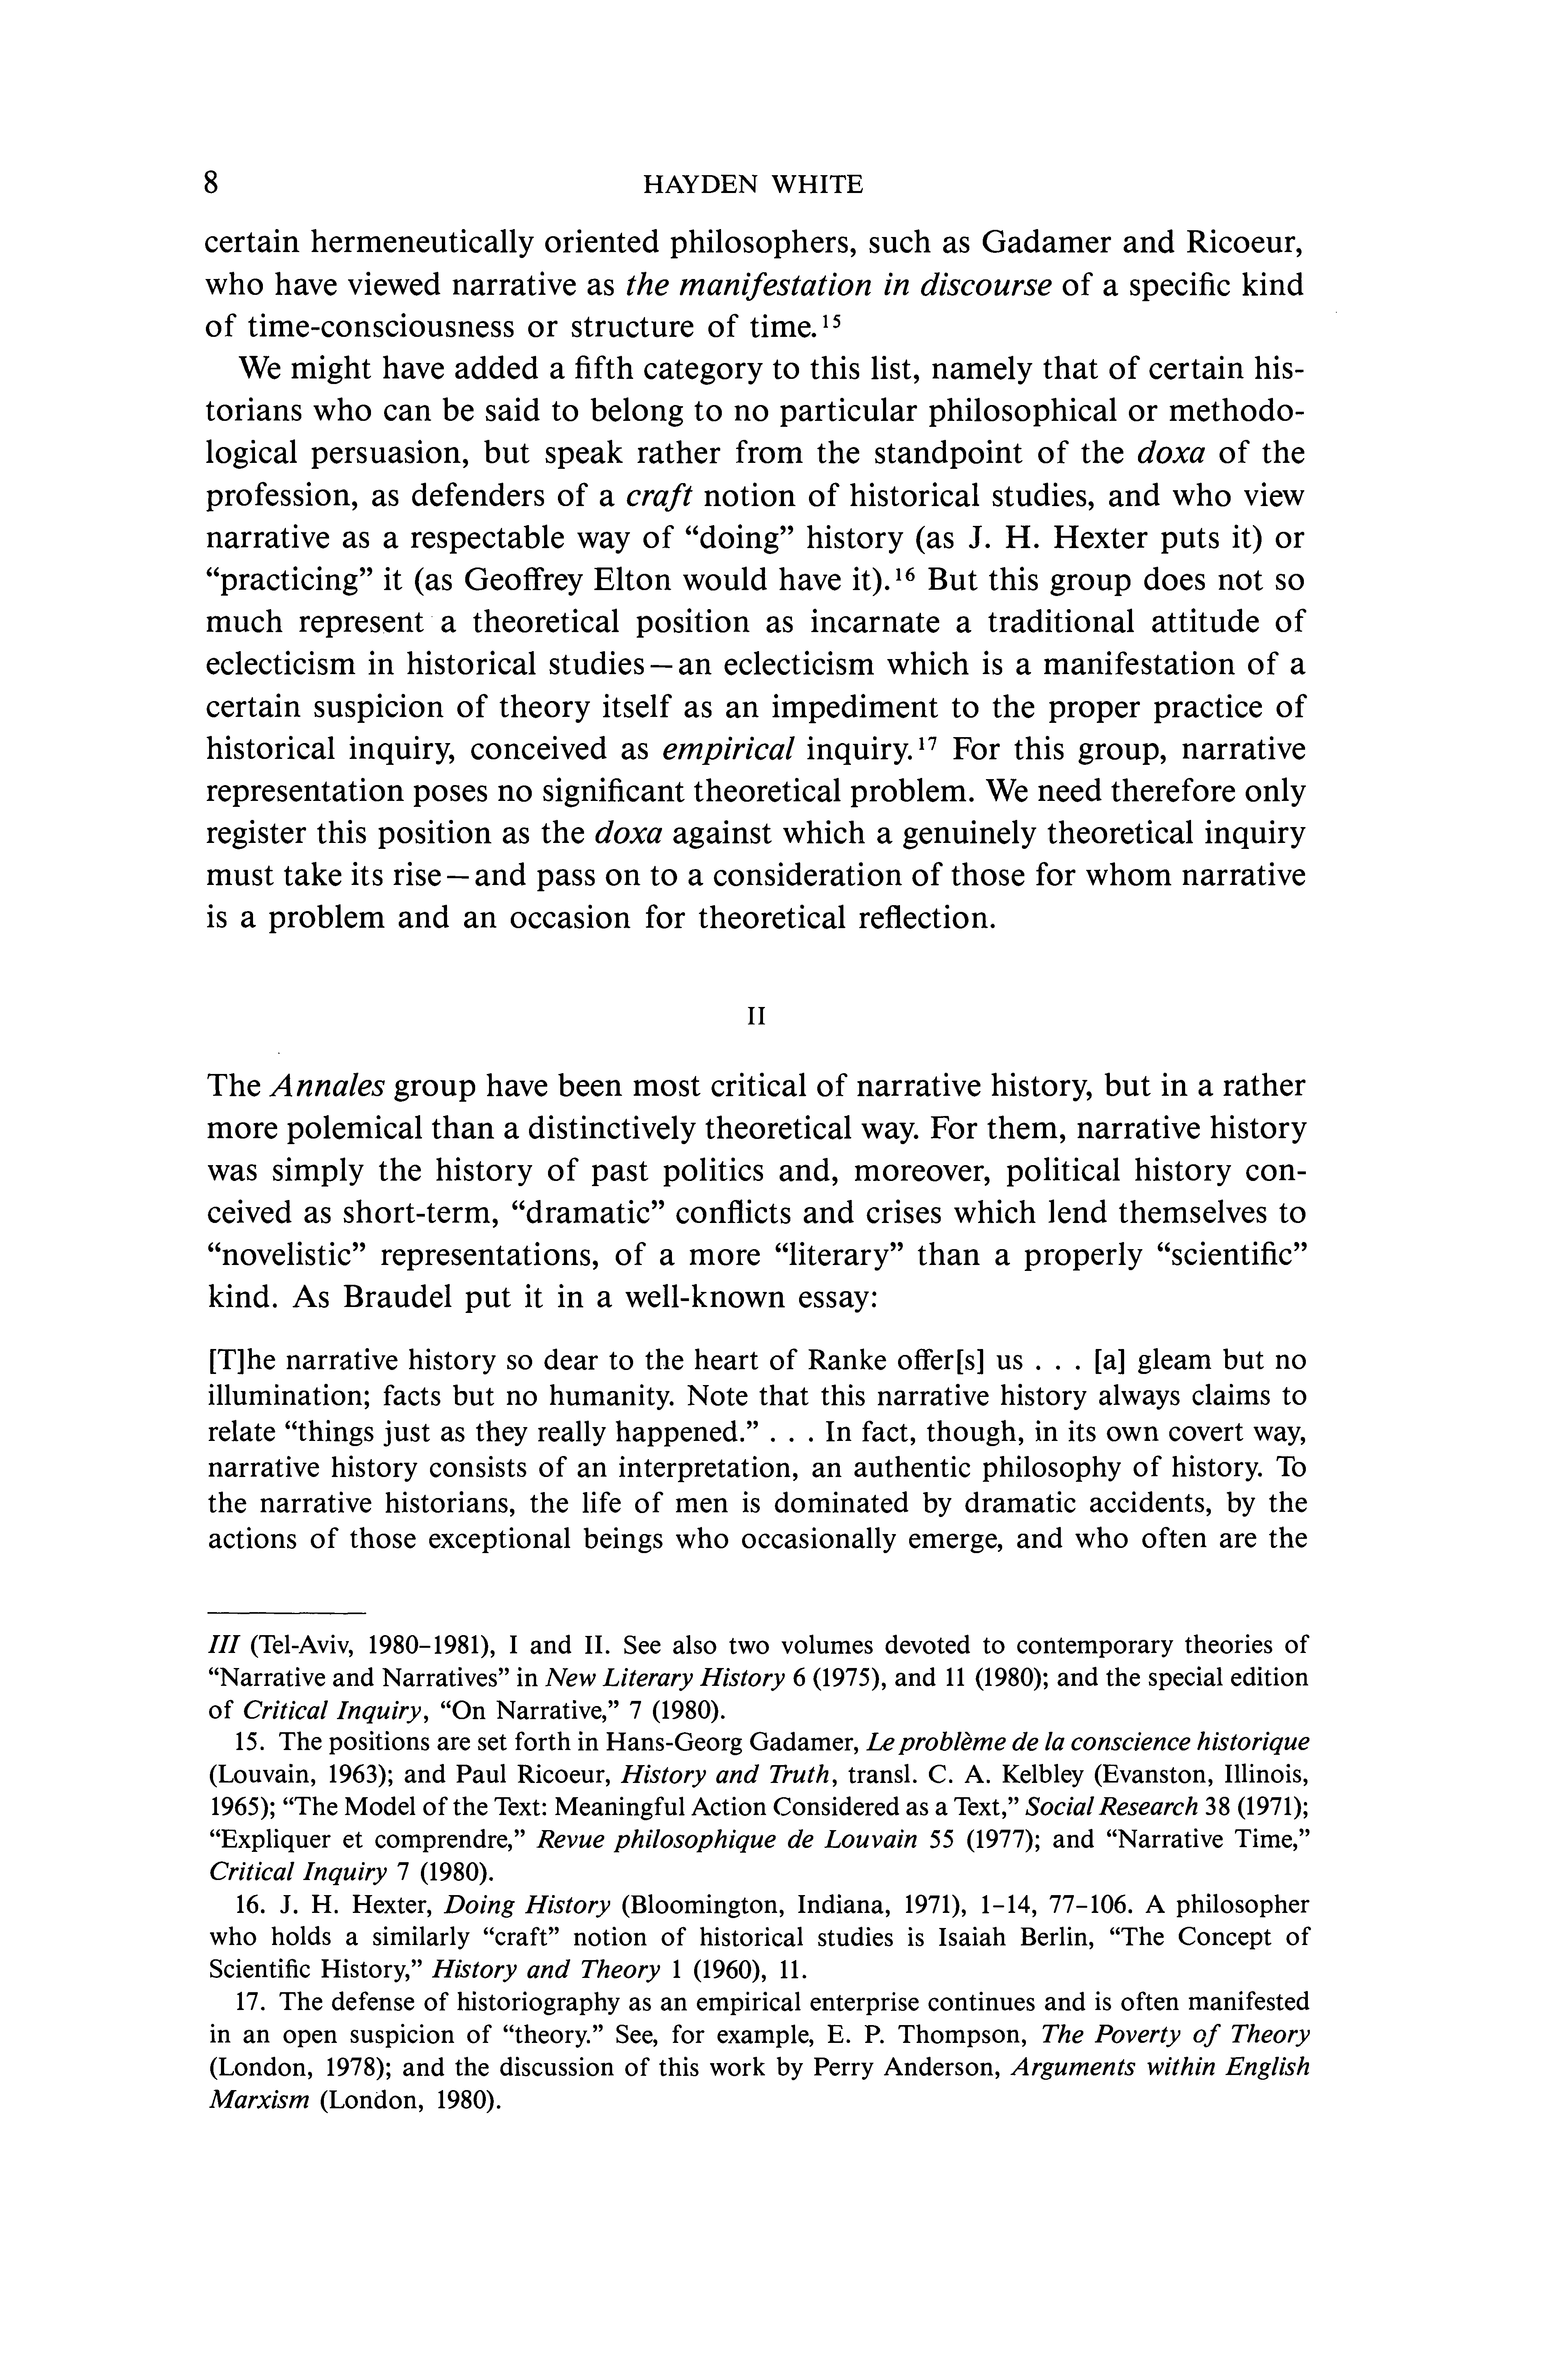

Slide 63
Continued
Meanwhile, in the 1970s another challenge the relationship between narrative history an argued that there was a disconnection between beginning, middle, and end - and life itself, w vein, Louis Mink noted "(1) that the world is no of well-made stories; (2) that we make such story referentiality by imagining that in them the w the historical narrative poses a dilemma. While the past, as narrative, it is the result of the narrative
According to Hayden White, central to this there is a deep structural, linguistic basis unde He argued that historical works are literary c torical explanations differed, not because of f because of differences in their emplotment m tragedy, satire - as well as in their "tropo figurative representations of metaphor, meto irony.10 As Paul Roth explains, "There is no tr the statement that such and such a happening telling which so presents it." White said it th really present itself ... in the form of well-m subjects, proper beginnings, middles and ends itself ... as a mere sequence without beginning or end.

Slide 64
Generalization
Generalisation is a process of framing principles, theories, and concepts by establishing relationship between facts. Generalisations can be drawn out from the facts through its systematic analysis and interpretation. Though historians have different views regarding the role of historical generalisation, it is widely accepted as an inevitable part of historical research. In the words of Lord Acton “History is a generalized account of the personal stories of men united in bodies for any public purposes whatever”. E.H. Carr emphatically contended that history is social science, not art, because historians, like scientists, seek generalizations that help to broaden the understanding of one's subject.

Slide 65
Continued
In the development of historiography, several historians tried to find out general laws or principles in explaining the historical process. Thucydides synthesized historical facts in order to construct general principles based on morality and ethics. St. Augustine formulated his providential philosophy of history to present historical progress. Positive philosophers formulated new principles and generalizations on a scientific basis. Many philosophers of history and theoreticians tried to explain historical events through the theoretical and conceptual frames. An array of intellectuals like Rousseau, Gibbon, Carlyle, Niebuhr, Ranke, Comte, Mill, Kant, Hegel, Buckle, Spengler, Marx, Toynbee, and so on used history to draw generalizations to explain the fundamental forces and factors that prompted historical events.

Slide 66
Features and Importance of Generalisation
Many historians consider the purpose of generalization is to learn lessons from history.
Generalisations are necessary in history in order to explain the fundamental forces that prompted events in the past.
A generalisation about a series of historical events will help draw all the separate details into an overall pattern.
Generalisation enables the historian to predict the future by outlining overall patterns in historical progress.
Generalisations enable us to explain the processes and events we experience.
Generalisation often explains the cause and its effect.
Generalisation describes two or more concepts and relationships among them.
Generalizations link facts and concepts and summarize human experiences.

Slide 67
Debate on Historical Generalisation
The idea of historical generalisation was rejected by many historians. They argue that in history, it is not possible to formulate generalizations, because the pact cannot be directly observed. History deals with a sequence of unique events, hence it is not possible to draw generalisation. History does not repeat itself and thereby, generalization is not possible and the future cannot be predicted with certainty.
Another view holds that the generalisation is the duty of every historian, which makes his account knowledgeable. History can offer broad principles and generalizations and exhibits common trends, tendencies, and patterns. Cultural content is common to humanity. All the known civilizations have developed along similar lines. This repetitive nature of history enables the historian to generalize. Generalization is possible because historical events are strikingly similar.

Slide 68
Conclusion
A generalization must be based upon a balanced approach. Theories are one of the prominent sources for generalisation in history. Many historical generalisations are driven from life experiences. Historians also derive generalisations from the study of the present. Also, derive generalisations from active data collection and its systematic analysis. In short, “All historians practice generalization anyway”.

Slide 69
RESEARCH PROCESS
IN
HISTORY

Slide 70
Three Must Knows of Research
Research Problem
Research Methodology
Research Objective

Slide 71
Stages
Phase I
DECIDING WHAT TO RESEARCH
Formulating a Research problem
Phase II
PLANNING A RESEARCH STUDY
Conceptualizing a research design
Phase III
CONDUCTING A RESEARCH STUDY
Collecting data
Constructing an instrument for data collection
Selecting a sample
Writing a research proposal
Processing an displaying data
Writing a research report

Slide 72
Deciding what to do
RESEARCH PROBLEM
Before any action be taken one needs to decide what to do and how
Therefore, before one begins to research a decision needs to be made about two things:
1) what you need to find out/ or what is your research question.
2) how to find out its answer?

Slide 73
How to do it
RESEARCH METHODOLOGY
Once the problem or the question to be answered is identified then a method to answer it needs to be found out
There are two types of research methodology:
1) QUANTITATIVE 2) QUALITATIVE
Though broadly the same, the methods differ on the basis of their model of date collection, process of data analysis and the style of communication of the finding

Slide 74
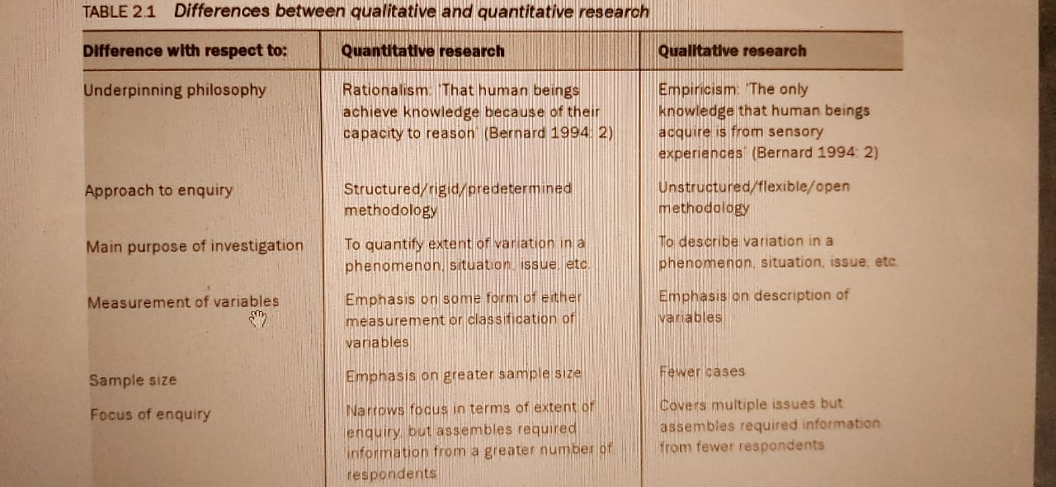

Slide 75
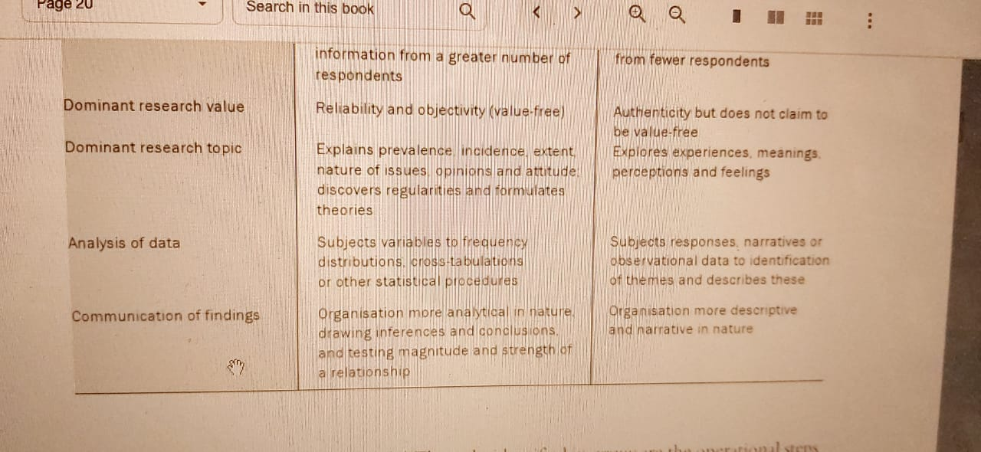

Slide 76
Literature Review
Before research is undertaken the gap that has been identified, the question to be answered, can be done so only when the previously written works on the selected topic is thoroughly read and scanned for faultlines
Reading the existing works helps identify the gap within the existing answers
This helps in framing the question
The process of reading existing historical works can be identified as LITERATURE REVIEW

Slide 77
Functions of literature review
It provides a theoretical background to your study
It helps you establish a link between what you are proposing to examine and what has already been studied
It enables you to show how your findings have contributed to the existing body of knowledge
Helps you integrate your research findings into the existing body of knowledge

